Slide 1
Clean code

Slide 2
Three Principles for Clean Code
Right tool for the job
Watch for “boundaries” between technologies
High signal to noise ratio
TED principle: Terse, expressive, do one thing.
DRY: Don’t repeat yourself
WET
Self document code (expressive code)
Clear intent
Layers of abstractions
Notes:
JavaScript is the wrong tool for storing markup
Filpside it’s tempting to put JavaScript directly in HTML
Injecting behavior directly into markup and it eliminate the opportunity for caching ang reuse

Slide 3
High signal to noise ratio
TED rule: Terse, Expressive, Do one thing
Noise:
High cyclomatic complexity
Excessive indentation
Zombie code
Unnecessary comments
Poorly named structures
Huge classes
Long methods
Repetition
No whitespace
Overly verbose

Slide 4
DRY principle
Don’t Repeat Yourself
WET (Write Everything Twise)
Normalized Database:
Each pieces of data is defined in a single place.
Operates: efficiently, consistently and easy maintenance
Copy an past is often a design problem
Notes:
Decrease signal to noise ratio
In dreses the number of lines of code
Creates a maintencence problem

Slide 5
Self-documenting code
Well written code is self-documenting
Express intent clearly
Layers of abstractions
Format for readability
Favor code over comments

Slide 6
Naming Classes
A well designed Class should have a single responsibility
Is tricky judgment call but it’s certainly helpful to regulary ask yourself if class is doing to much
Guidelines
Noun: because your creating a thing creating instance of that thing
Be Specific :
High Cohesion
Low Cohesion (doing too many thing)
Signle responsibility
Avoid name and generic suffixes
Is it instance of that logical

Slide 7
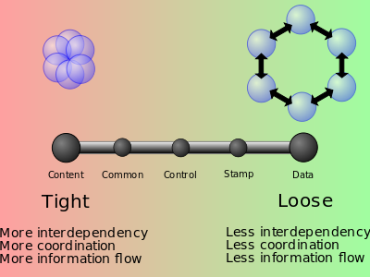
Cohesion vs Coupling
Cohesion | Coupling
Functional | Data
Sequential | Stamp
Communicational | Control
Procedural | Common
Temporal | Content
Logical
Coincidental (utilities)
An important design objective is tom maximize the module cohesion and minimize the coupling
Notes:
Logical: do the same thing even thought they are different nature (mouse et keybord input handling routine)
Temporal: when parts of a module are grouped by when they are processed- the parts are processed at a particular time in program execution (function which is called after catching an exception which closes open files, creates an error log, and notifies the user)
Procedural: parts of a module are gouped because they always follow a certain sequence of execution (function which checks file permissions and then opens the file)
Communicational: grouped because they operate on the same data
Sequential: part of module are grouped together because the output of on part is the input of the anther part (read data file then process that data)
Fuctional : they are grouped because they all contribute to a single well-defined task of the module (xml lexical analyse)

Slide 8
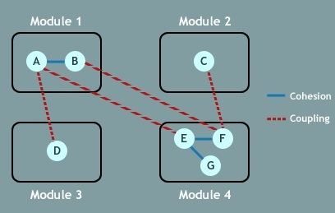

Slide 9
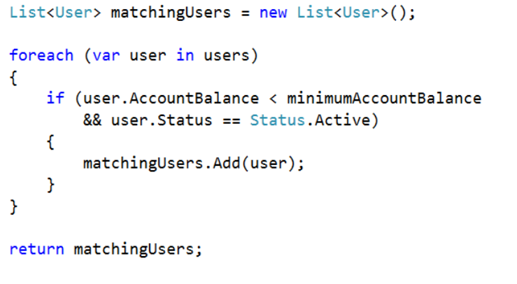
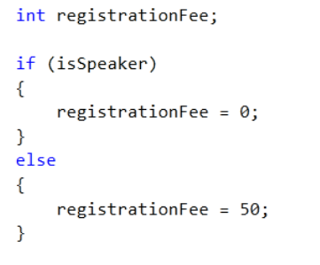

Slide 10
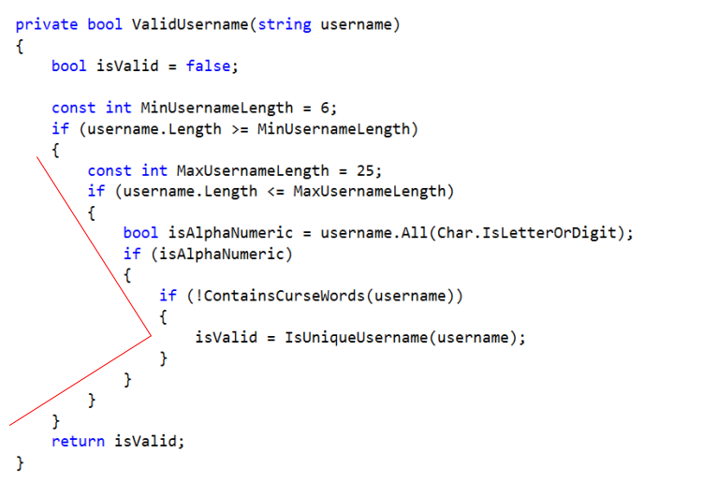

Slide 11
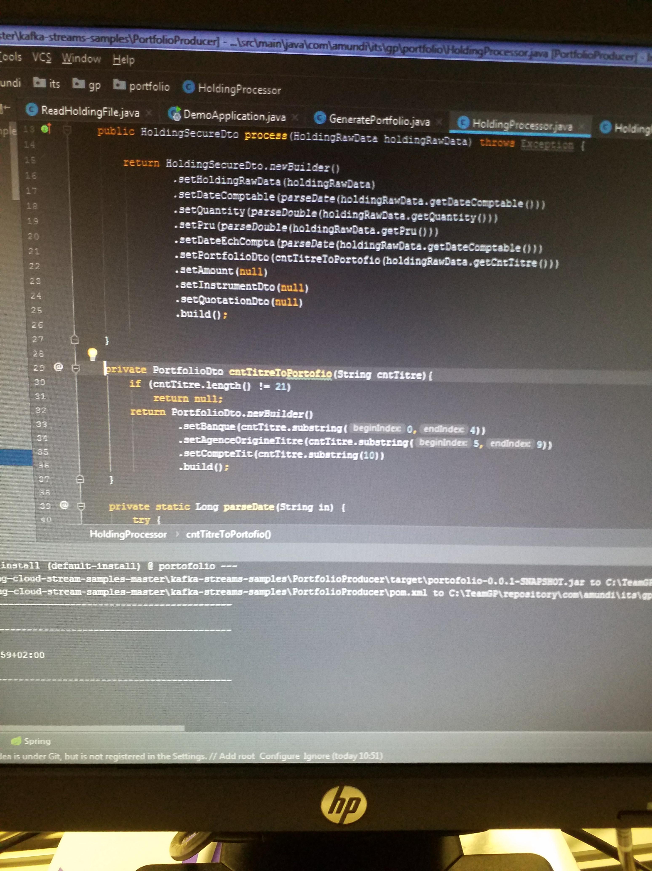

Slide 12


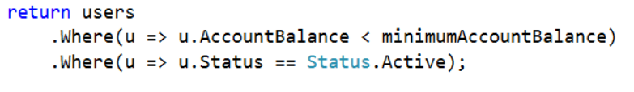

Slide 13
